Slide 1
Zomato Restaurant Insights Dashboard:
A Global Analysis
BY,
ANURADHA SATHYASHEKAR,
KURUPATI SOWKHYA,
ADDANKI VISHNUVARDDHAAN,
KALIKIVAYEE BHUMIKA,
KAUKUNTLA VIDYA
(GROUP 5)

Slide 2
INTRODUCTION
Zomato is an Indian-founded online food delivery, restaurant discovery, and table reservation company, established in 2008 by Deepinder Goyal and Pankaj Chaddah
Originally named Foodiebay, it rebranded to Zomato in 2010 to expand its scope beyond food.
Today, the company provides a range of services, including online food ordering and delivery.
Objective
To analyse Zomato project performance using data dashboards .
To identify success factors in Zomato project.
To study trends over time (2010–2018) in ZOMATO MARKET AND CONSUMER ANLYSIS
To compare dashboards across tools for visualization and insights.

Slide 3
KPIS
KPI 1: Data Model Building: Established relationships between tables for seamless analysis.
KPI 2: Calendar Table Creation: Added fields: Year, Month, Quarter, Weekday, Financial Month, and Financial Quarter.
KPI 3: Cost Conversion (Local → USD): Enabled uniform comparison across all countries.
KPI 4: Restaurants by City & Country: Counted total restaurants per city and country.
Highlighted top-performing regions for business expansion.
KPI 5: Restaurant Openings by Time Period: Identified restaurant growth trends over time.
KPI 6: Count of Restaurants by Rating: Showed distribution of high, medium, and low-rated restaurants.
KPI 7: Price Buckets Analysis: Analyzed how many restaurants fall under each price range
KPI 8: Table Booking Percentage: Indicates dine-in convenience and customer preference levels.
KPI 9: Online Delivery Percentage: Reflects digital adoption and growth of online food services.
KPI 10: Cuisine, City, and Ratings Analysis: Analyzed cuisine popularity by city and rating levels. And identified high-performing cuisines and regional preferences.
KPI 11: Dashboard Creation: Built interactive dashboards in Excel, Power BI, and Tableau.

Slide 4
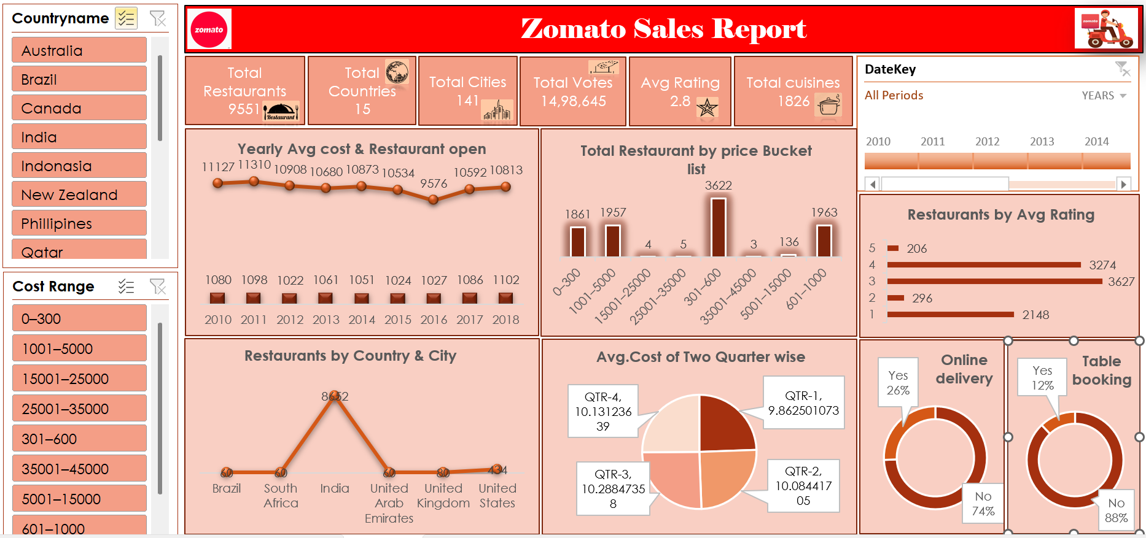
Excel Dashboard

Slide 5
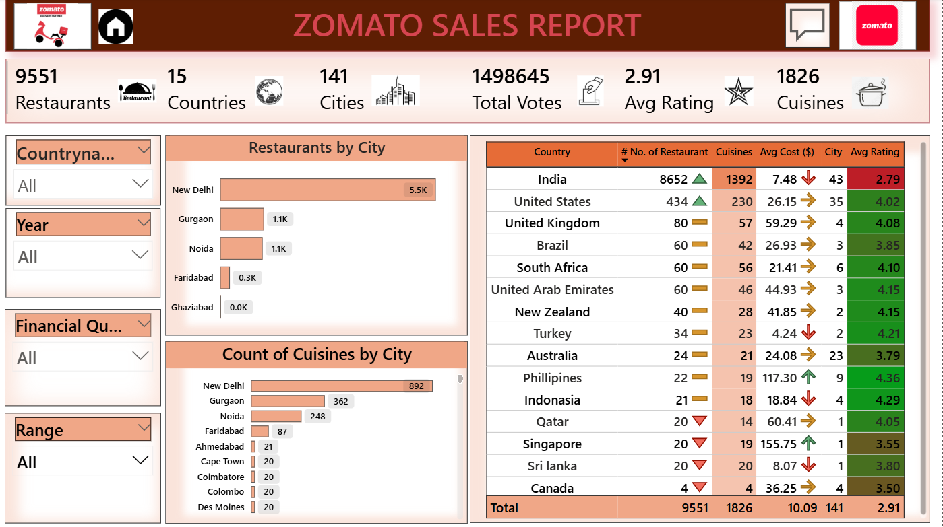
Power BI Dashboard

Slide 6
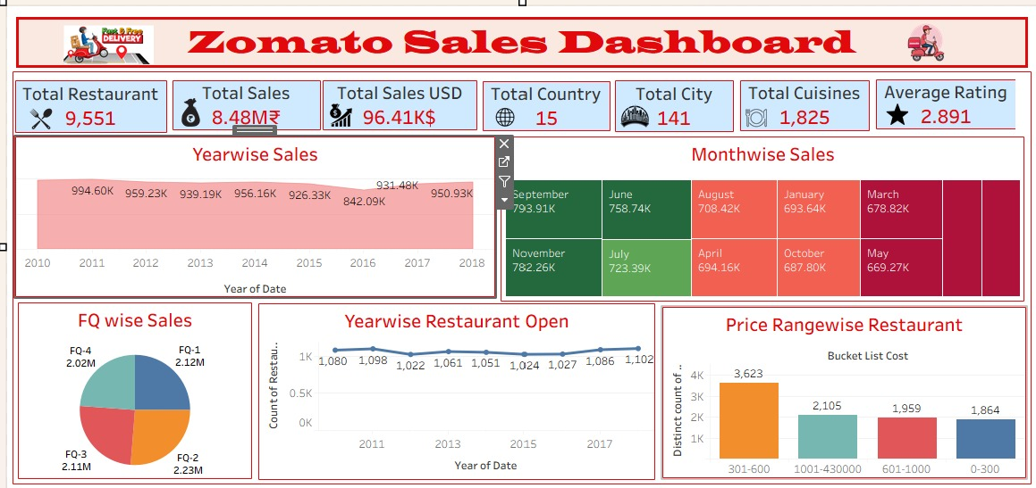
Tableau Dashboard

Slide 7
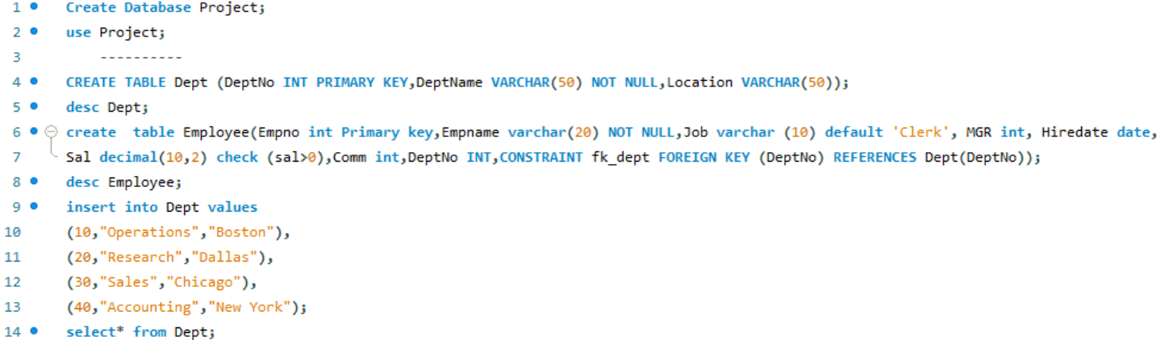
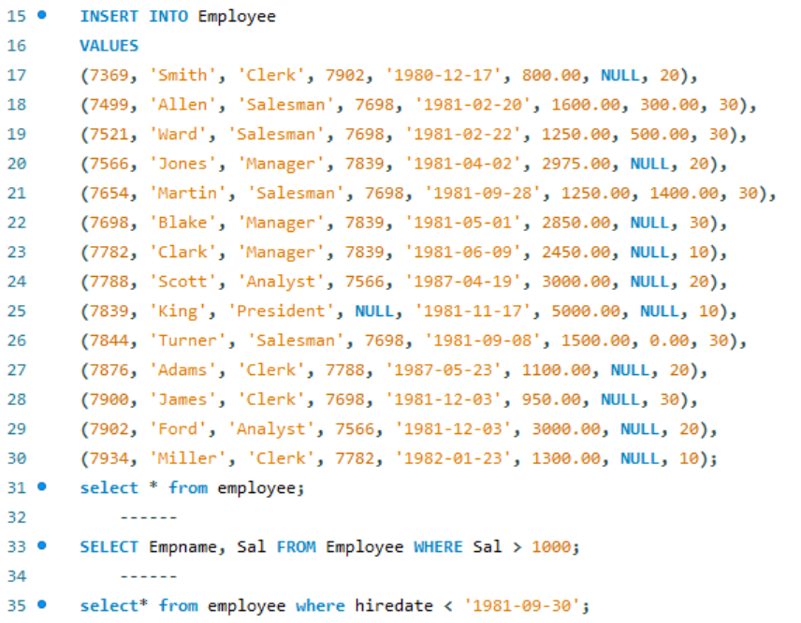
SQL (EMP case study)

Slide 8
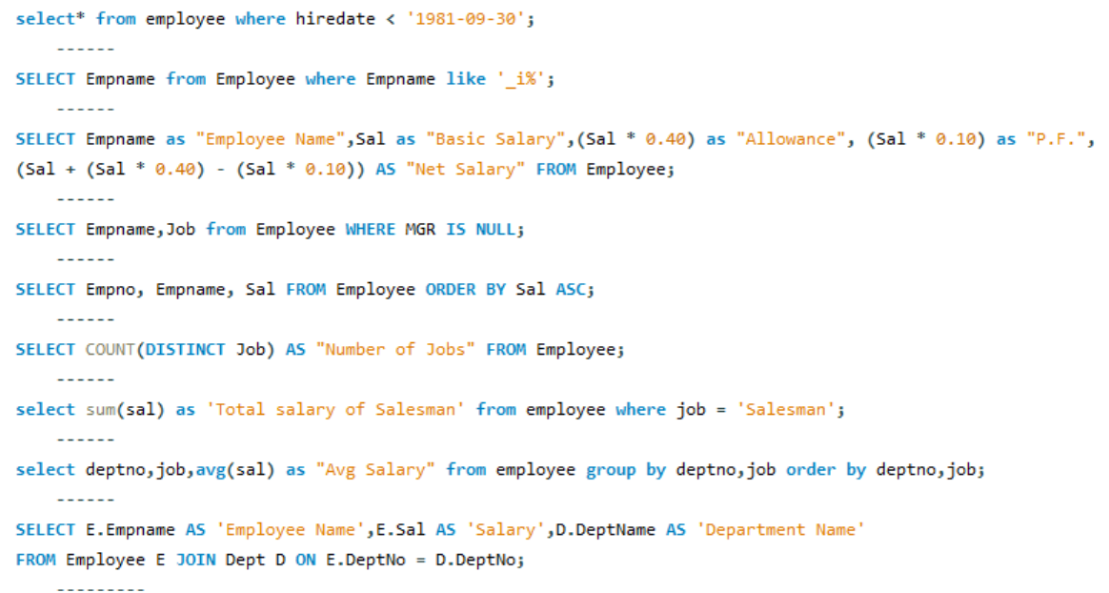
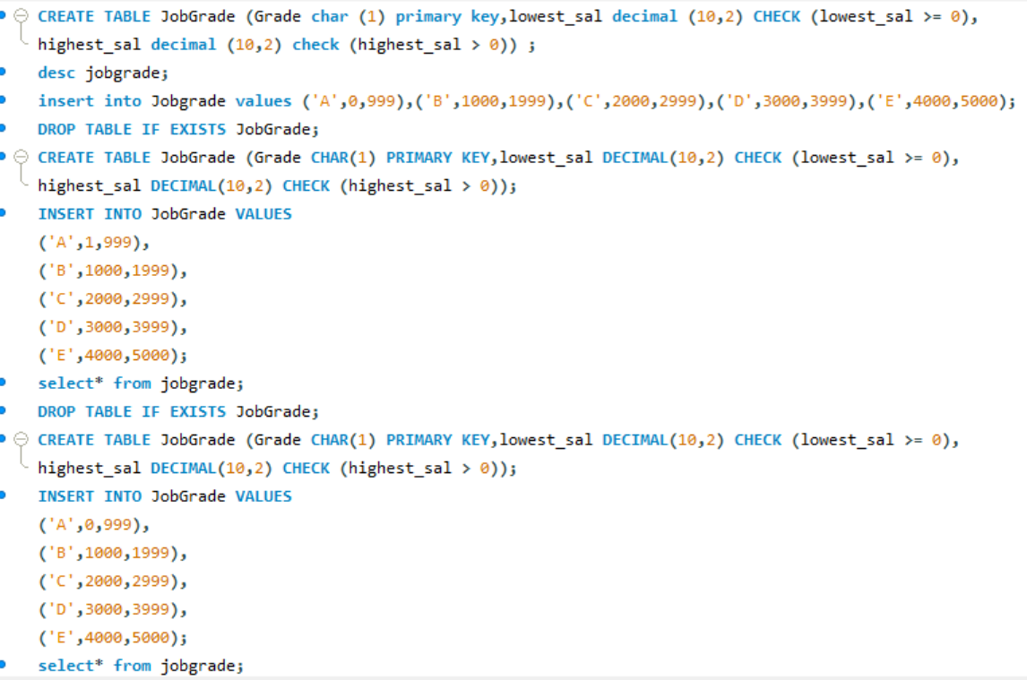
SQL (EMP case study)

Slide 9
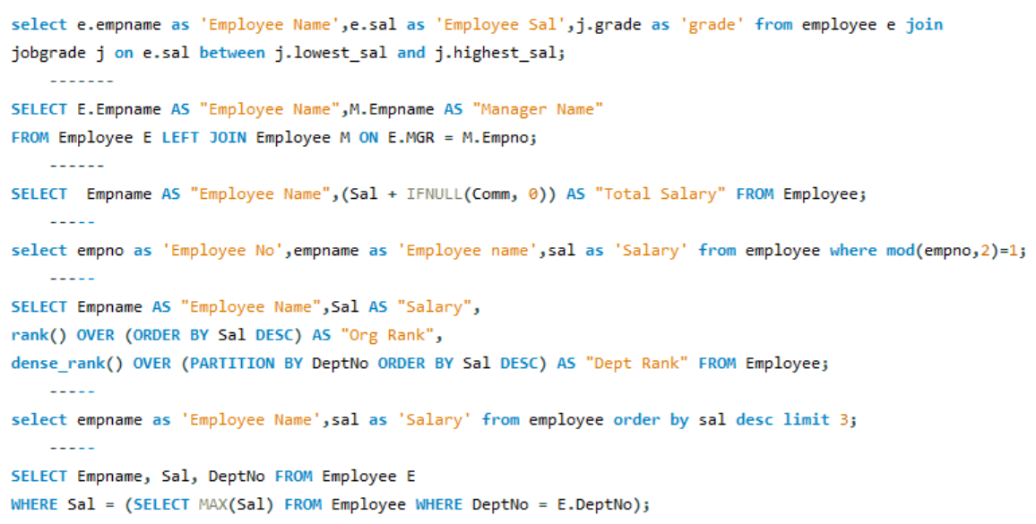
SQL (EMP case study)

Slide 10
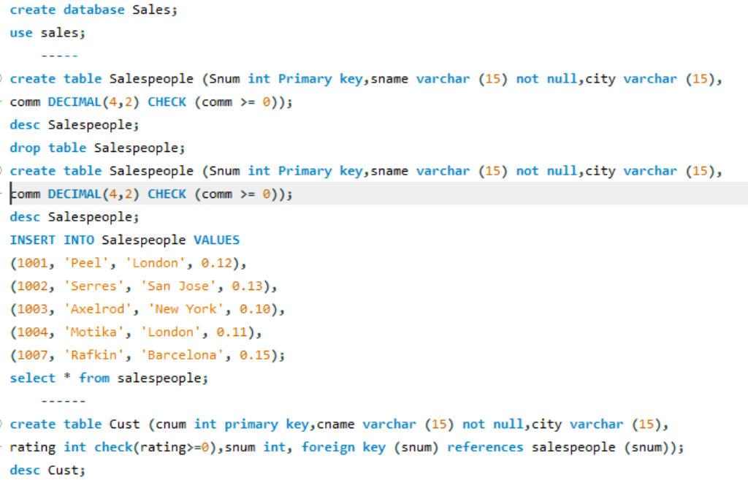
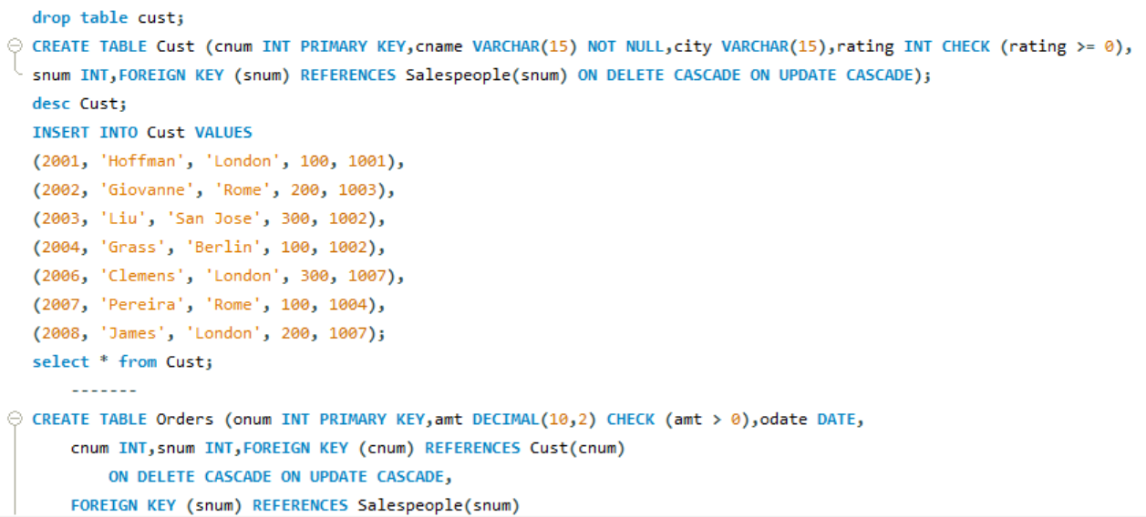
SQL (SALES case study)

Slide 11
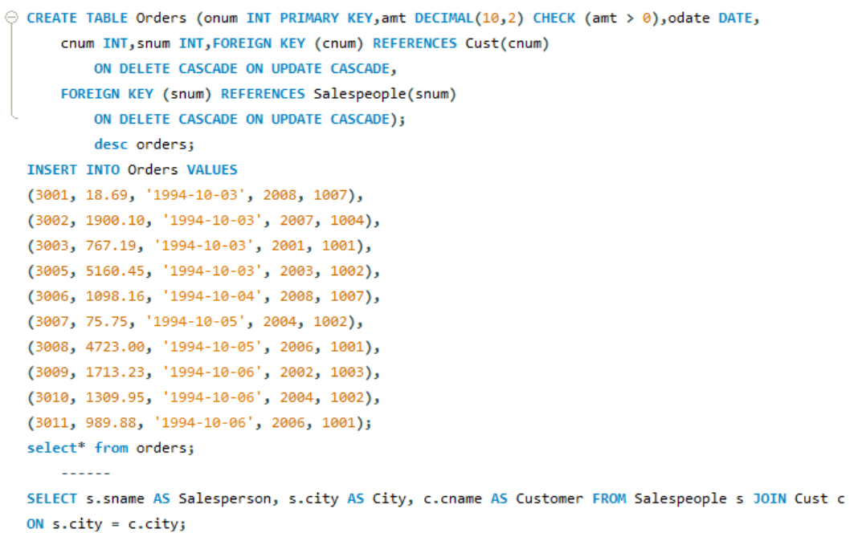
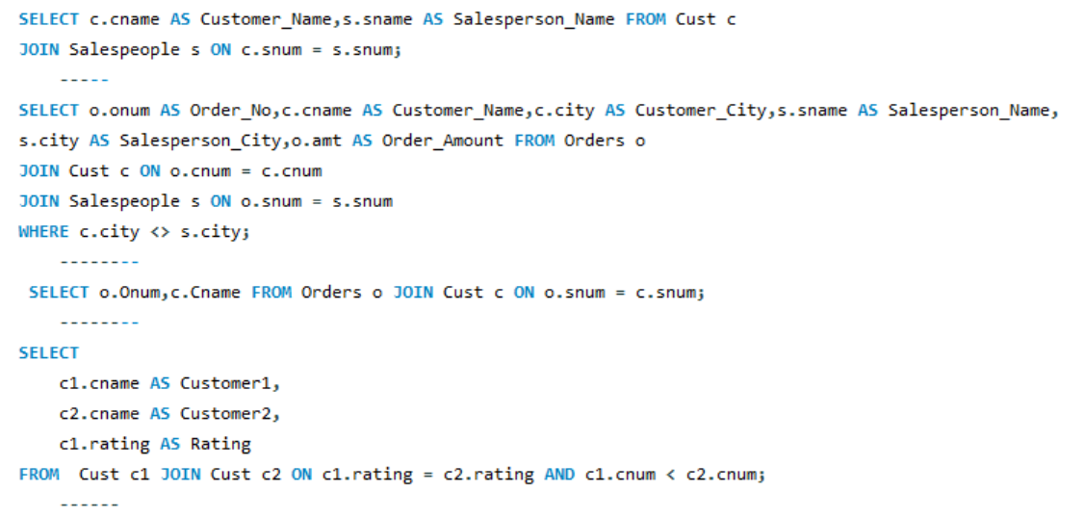
SQL (SALES case study)

Slide 12
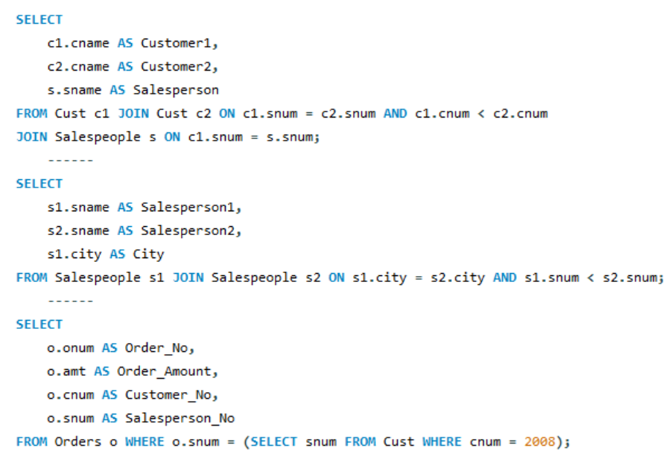
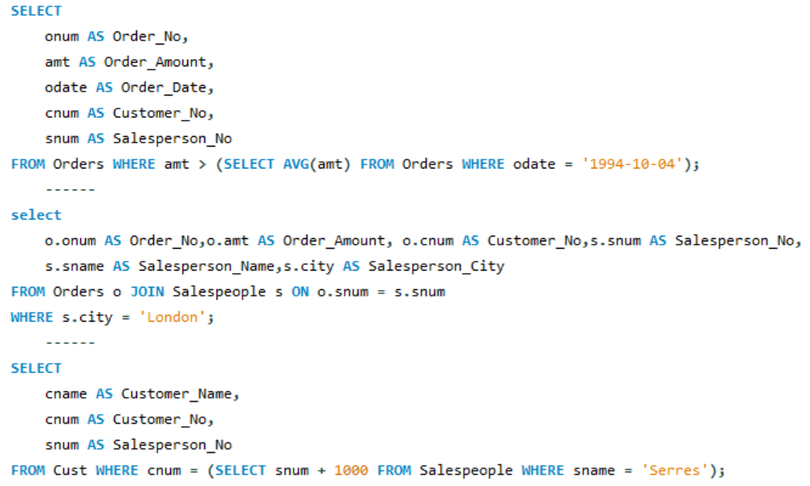
SQL (SALES case study)

Slide 13
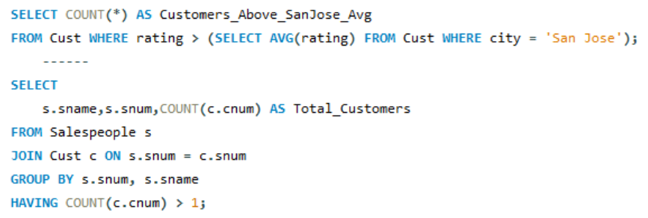
SQL (SALES case study)

Slide 14
One-line Summary
Total records: 9,551 restaurants dataset
Core market: India dominates the dataset with majority of restaurants, followed by UAE, United Kingdom, and Turkey. (Emerging restaurant hubs include Dubai, London, and Doha, showing international Zomato penetration).
Top city: New Delhi with highest number of restaurants,
Avg rating (approx): 2.9 suggesting room for quality improvement.
Avg cost for two: <= $10 USD after currency conversion.
Booking & delivery adoption: Table booking ~12%, Online delivery ~26%.
Cost buckets: ~32% in 0–300, ~30% in 301–600, remainder skewed to lower-cost ranges. (large market for budget and casual dining.)
Cuisine Insight: North Indian cuisine leads the list, followed by Chinese, Fast Food, and Continental.
Openings peak: 2015–2017; Q3 shows many openings.

Slide 15
Strategic Recommendations
Enhance digital integration: Focus on onboarding of restaurants for online delivery and table booking.
Leverage cuisine insights: Promote top cuisines in targeted regions to drive local engagement.
Improve service quality: Low average rating implies need for partner restaurant training or stricter quality filters.
Target marketing by geography: Use city-level analysis to prioritize Zomato Gold or Pro membership in high-volume cities.
Capitalize on cost segmentation: Tailor promotional offers to the large mid-range (0–600) customer base for better results.
By focusing on digital adoption, customer experience, and targeted pricing strategies, Zomato can continue to scale its restaurant ecosystem efficiently.

Slide 16
"Decoding the Best Tool for Your Data Story"
EXCEL
💡 What it is:
Microsoft Excel is a spreadsheet tool primarily used for data entry, calculations, and small to medium-scale data analysis.
🧠 Core Strengths:
Easy to learn, very familiar interface.
Great for quick data cleaning, formulas, pivot tables, and charts.
Flexible for basic dashboards using slicers and conditional formatting.
⚠️ Limitations:
Not ideal for large datasets (slows down after ~1M rows).
Manual updates — no live data connections (unless using Power Query).
🧾 Best for:
Small-scale reports, ad-hoc analysis, finance teams, or individuals working with structured data.

Slide 17
"Decoding the Best Tool for Your Data Story"
POWER BI
💡 What it is:
Power BI is Microsoft’s Business Intelligence (BI) platform for interactive dashboards and live reports.
🧠 Core Strengths:
Interactive dashboards with drill-downs and filters.
Auto-refresh and online sharing via Power BI Service.
Can handle millions of rows easily and Integrates seamlessly with Excel, SQL Server, Azure, etc.
⚠️ Limitations:
Visual customization is slightly limited compared to Tableau.
Needs some learning (DAX, Power Query concepts). DAX formulas enable advanced metrics and KPIs.
🧾 Best for:
Corporate dashboards, KPI tracking, automated reporting in Microsoft ecosystems.

Slide 18
"Decoding the Best Tool for Your Data Story"
TABLEAU
💡 What it is:
Tableau is a data visualization and analytics tool focused on visual storytelling and exploration.
🧠 Core Strengths:
Handles big data very efficiently and creates rich, beautiful visuals with design flexibility
Very strong in data exploration and pattern detection.
Supports drag-and-drop analytics with dynamic parameters.
⚠️ Limitations:
Higher cost (enterprise-level).
Collaboration requires Tableau Server or Tableau Cloud.
🧾 Best for:
Data analysts, data scientists, and enterprises focusing on storytelling, pattern analysis, and visuals.

Slide 19
"Decoding the Best Tool for Your Data Story"
Feature / Tool | Excel | Power BI | Tableau
Type | Spreadsheet | BI & Visualization | BI & Visualization
Ease of Use | ⭐⭐⭐⭐⭐ | ⭐⭐⭐ | ⭐⭐
Visual Quality | ⭐⭐ | ⭐⭐⭐⭐ | ⭐⭐⭐⭐⭐
Handles Big Data | ❌ | ✅ | ✅
Automation / Live Data | ❌ | ✅ | ✅
Integration (MS tools) | ✅ | ✅ | ⚙️ Limited
Storytelling / Dashboards | ⭐⭐ | ⭐⭐⭐⭐ | ⭐⭐⭐⭐⭐
Cost | Low | Moderate | High
Ideal User | Beginners / Finance | Business Users / Analysts | Analysts / Data Scientists
Your Goal | Recommended Tool
Simple data analysis, formulas, pivots | EXCEL
Corporate dashboards, automation, real-time reporting | POWER BI
Advanced analytics, storytelling, deep data visuals | TABLEAU

Slide 20
"Decoding the Best Tool for Your Data Story"
SQL (Structured Query Language)
💡 What it is:
SQL (Structured Query Language) is the standard language for managing and analyzing data stored in relational databases.
  It stores, retrieve, update and delete data in database.
  Analyse data using queries and aggregations and manages database structure.
🧠 Core Strengths:
SQL uses simple English-like syntax (SELECT, FROM, WHERE) — easy to read and write even for beginners.
You can quickly fetch and filter millions of records using optimized queries.
SQL can perform complex calculations, summarizations, and comparisons — making it ideal for analysts.
Works with most BI tools like Power BI, Tableau, and Excel, enabling seamless data connection and visualization.
SQL queries help transform raw data into actionable insights for business intelligence.
Works across many systems (MySQL, SQL Server, Oracle, PostgreSQL, SQLite).

Slide 21


